Slide 1
Advanced ZOOM
3.19

Slide 2
Zoom Basics
For the basics of how to use ZOOM, see the “ZOOM basic training” (Approx 15 minutes)
https://youtu.be/rUUG85JPYSI
This training video cover:
Joining a meeting you were invited to
Managing your experience in the meeting
Creating a ZOOM account
Setting up meetings
Running meetings/host settings
ZOOM Apps

Slide 3
Advanced ZOom topics
Meeting settings
Polling
Settings “Add polls to meeting”
Recording
Sharing computer sound
Making someone a host/cohost
Sharing a file in “Chat”
Annotating and Whiteboard
Remote control
Managing breakout rooms

Slide 4
Setting up ZOOM settings
Login at ZOOM.us

Slide 5
Meeting Settings
One of the first advanced features of using ZOOM is getting comfortable with meeting settings.
Login to your online ZOOM account at ZOOM.us
Once logged in, click “Meeting settings
You will have a long list of possible settings.
Many of the important ones are enabled from the start.
However, check:
“File Transfer”
“polling”
“Annotation”, “Whiteboard”
“Remote control”
“Breakout room
Online demo

Slide 6
Recordings
If you click the “recordings” tab, you see all of your “cloud-based recordings”. That is where they are saved.
You can Share them with a link or download them

Slide 7
Polling Setup
After setting up a meeting on the “meetings” tab, you can set up a poll.
Click on the meeting you want to set up the poll for.
At the bottom of the meeting screen click “Add” to create a new poll.

Slide 8
Creating a poll
After clicking “Add” a poll, you will have the option to enter questions.
You will need to set this up before the meeting if you want to use the poll during the meeting.

Slide 9
Utilizing advanced features in a zoom session

Slide 10
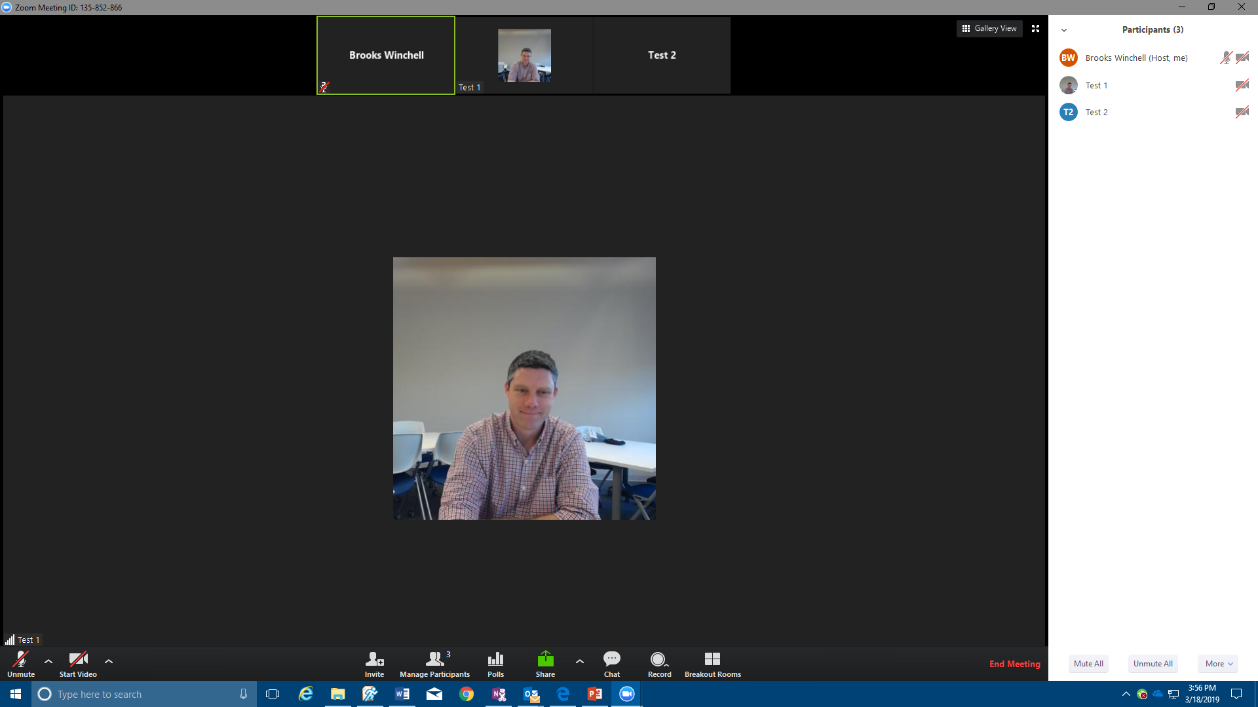
In meeting – starting a poll
Once you start your ZOOM meeting , you will now see a poll button here.
Click that button to start the poll

Slide 11
Polling function
You will have a window displaying your poll.
Click “Launch Poll”, and it will become available for all participants on their screens.
As participants fill out the poll and click “Submit”, the results of shared back to the host’s view in a window like this.
After everyone has gone, the host can then “Share the poll results” with all participants.

Slide 12
Recording
Another advanced feature for ZOOM pro users is “Record.”
If you are hosting a session, and you want to record, click “record” and then choose “record to this computer” or “record to the cloud.”
“Cloud recordings” will show up in your online dashboard under “recordings”.
When you are done recording, click the stop button, which will replace the record icon.
Recorded sessions show two windows: The shared content and the active speaker.

Slide 13
Sharing Video
While sharing your screen, you can share most videos on your screen (note: some copyrighted material may not display via ZOOM).
Call up the video, but before playing, click “more” and “Share computer sound.”
This will share the sound for other participants. However, you will need to turn down your computer volume to avoid duplicate sound.

Slide 14
Making someone a co-host
You can elect to make another participant a co host. That will give the person the ability to run breakout rooms, record, and manage participants.
Click “Manage participants.”
Then, in the participant dialog window on the right, click “more” next to the person’s name and click “make co-host.”

Slide 15
Collaborative Tools

Slide 16
Sharing Files via Chat
Another helpful advanced feature is the file sharing feature.
If you click the “chat” button, it opens up the Chat dialog on the right of the screen.
If you click the “more” button on the right, you will see the “Share file in meeting” button.
Click that, and it opens up a browser that allows you to attach files right in the chat.
All participants can then download the file to their computers.

Slide 17
Annotating a shared screen
While you or another participant is sharing a screen, all participants have the ability to annotate.
On the top bar, click “Annotate”
You will see this Tool bar pop up
You can draw, create textbooks, use the spotlight to collaborate.
At the end, you save the annotations

Slide 18
Whiteboard
Another similar feature to annotation is using the Whiteboard.
If you click “Share” and select “whiteboard”, you will get a blank white screen with annotation tools like this.
You can use it to collaborate, for sharing ideas, or for tutoring.

Slide 19
Requesting Remote Control
Another great advanced ZOOM feature is “Remote Control”. This allows you to control a presenter’s screen.
In this example, we are viewing another participants shared screen.
If we want to control that, click “View options” at the top and then click “Request Remote Control.”
Then click “request”, and a request will be sent to the person sharing his/her screen.

Slide 20
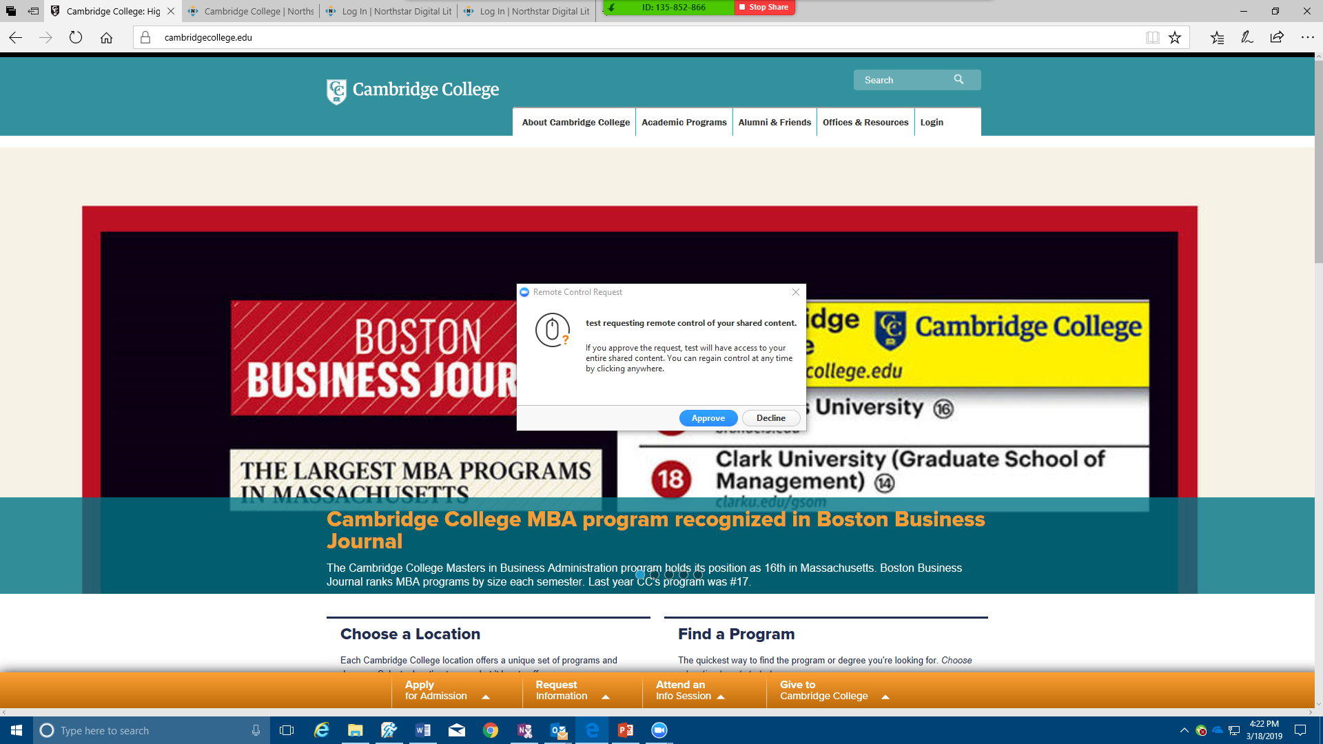
Allowing Remote control requests
If you are sharing your screen and someone sends you a request to remotely control, you will get this dialog box.
You can approve the request or decline it.
If you approve it, someone else will be able to control your screen/computer and access anything you are sharing.
If you are sharing the “screen” that person could potentially access anything on your computer.
However, this could be great for tutoring or collaborative work.

Slide 21
Breakout Rooms
The last advanced ZOOM feature that is helpful is the “Breakout rooms feature.”
If you are the host, you will be able to move participants to breakout rooms by clicking “breakout rooms.”
The box that pops up allows you to automatically or manually assign participants into the number of rooms you choose.
Then click “Create rooms” and “open all rooms”
All of the participants will receive a message to “join”. They click that to enter the rooms.

Slide 22
Managing Rooms
When participants are in the rooms, as the host, you will have the ability to see who is in each room.
You can also join any of the rooms by clicking “join”
You can also Broadcast a message to all rooms (ie 5 minutes left).
Finally, you can “close all rooms.” When you close the rooms, participants will have one minute to join the main meeting before they are automatically added back.

Slide 23
Other features
The Features covered in this advanced ZOOM training add to the ones in the basic ZOOM training.
There are not any other major features, but there are minor ones that you can enable in the “Meeting settings” screen.
For questions or other issues, email CELT@cambridgecollege.edu

