Slide 1
Your career pathway: Creating a Career Plan
CENTER FOR CAREER AND PROFESSIONAL DEVELOPMENT
Presented by:
Irina Galatskaya, Manager of Career Services, Center for Career and Professional Development

Slide 2
AGENDA
Welcome & Introductions
Career vs Job: How They're Different and Why It Matters
Importance of Career Planning
Stages of Career Planning
1. Evaluating Myself
2. Exploring Career Options
3. Making Decisions
4. Setting Goals
5. Implementing My Plan
Notes:
A job is a task or series of tasks performed in exchange for money. It's a specific position of employment that can be full-time, part-time, or temporary (i.e., for a fixed term). It may or may not require special skills or training. The primary motivation for undertaking a job is to earn money, but you might also choose to try out different jobs in order to see which occupations suit you the best.
The typical career definition is more complicated. A career is the entire sequence of jobs you hold throughout your lifetime. It encompasses all the training and experiences that help you advance toward a larger aim, such as greater knowledge, increased satisfaction, higher earnings, or more responsibility. Building a career requires setting goals and often involves getting formal education or special training.
So, what's the difference between a job and a career? A job is something that is given to you, whereas a career is something that is created by you. You apply for jobs and may work a series of them without a lot of thought for the future. However, a career usually involves progressing in one occupational area or aiming for some sort of long-term goal. Thus, one of the key differences between "job" and "career" lies in the way you perceive the work.

Slide 3
“Life is the sum of all your choices”
Albert Camus, a French philosopher, author, and journalist. He won the Nobel Prize in Literature at the age of 44 in 1957, the second-youngest recipient in history.
Notes:
A job is a task or series of tasks performed in exchange for money. It's a specific position of employment that can be full-time, part-time, or temporary (i.e., for a fixed term). It may or may not require special skills or training. The primary motivation for undertaking a job is to earn money, but you might also choose to try out different jobs in order to see which occupations suit you the best.
The typical career definition is more complicated. A career is the entire sequence of jobs you hold throughout your lifetime. It encompasses all the training and experiences that help you advance toward a larger aim, such as greater knowledge, increased satisfaction, higher earnings, or more responsibility. Building a career requires setting goals and often involves getting formal education or special training.
So, what's the difference between a job and a career? A job is something that is given to you, whereas a career is something that is created by you. You apply for jobs and may work a series of them without a lot of thought for the future. However, a career usually involves progressing in one occupational area or aiming for some sort of long-term goal. Thus, one of the key differences between "job" and "career" lies in the way you perceive the work.

Slide 4
Career Planning is….
An active, ongoing & lifelong process that encompasses more than just looking at the next promotion.
More than just a job or series of jobs
Responsive to other life roles, such as community member, student, mother, father, child, etc.
Often considered a one-time event, normally to facilitate a school-to-work transition.
Career Planning doesn’t have to be about major career changes, although that can be the case. Instead, it’s about acknowledging that individuals continuously learn, grow and develop. They seek to align work with evolving skills and changing interests while also ensuring work “fits” within their lifestyle (ex: as family requirements change).

Slide 5
IMPORTANCE OF CAREER PLANNING
Career planning can help you to:
Enter the workforce
Plan for education
Deal with changing workplace demands
Anticipate trends or changes
Upgrade or maintain your skills; and
Prepare for career advancement
Career planning should be done on a regular basis. It allows you to be prepared for changes both personal and in the world of work to better prepare you to navigate those changes.

Slide 6
PLAN YOUR CAREER BEFORE YOU GRADUATE
If you are considering higher education to prepare you for a chosen profession, you might think that excelling at your course work and getting the best grades is your only focus. While these are certainly essential goals, there are other steps you should be taking to plan your career before you graduate.
It’s important that you separate yourself from the rest of the crowd that’s competing for the same dream job that you are!
The time is now to start planning for success in your field, so use these tips to make sure you’re the one getting hired.
Take the right approach to the workforce
Revisit your career planning goals regularly
Ensure you have or can obtain the right experience
Assess your interests, hobbies and motivations
Analyze trends in our chosen career and make adjustments as necessary
Consider internships for real life experiences
Notes:
1. Whatever field you choose, you should have very detailed knowledge about the job opportunity you’ll be looking at when you graduate. If positions can be hard to find, whether because theres intense competition or the job is highly specialized, you might need to consider another approach. The time and money you’ve invested to prepare for your career is meaningless if you cannot make a living at it.
2. You should review your goals and aspirations frequently as you plan your career before you graduate. Every few months, write down whre you want to be in one year, five years and ten years down the road. Revisit, adjust and add to these goals so you stay on the right track in your educational pursuits.
3. Excelling in the classroom alone isn’t enough to land you the perfect job, rather career when you graduate, especially when many other students have the same high grades.
A potential employer will be looking at your level of experience in addition to your education, so make sure you either have some or can arrange to obtain some. Internship is also a worthwhile pursuit.
4. A job shouldn’t be simply a way to earn a paycheck; rather, your career should be something you enjoy and that drives you to succeed.
5. Many fields experience ups and downs as the global shifts.
6. Internship are a great way to gain experience and learn more about your field.
No matter what field you choose, it is important to plan your career before you graduate if you want to find success. The ideal position isn’t just handed to you; it’s essential to earn it by showing that you possess qualities that other candidate don’t offer. There is no doubt that the right educational program is also critical, so you should invest tie and effort in finding the best available in your area of study.

Slide 7
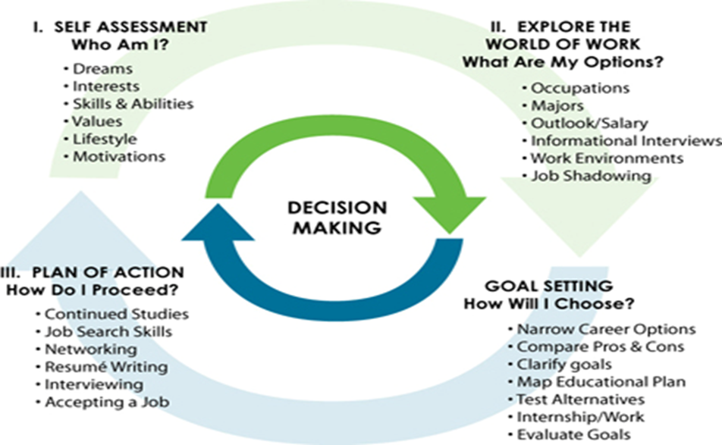
STAGES OF CAREER PLANNING
Evaluate/Assess Myself: learning about yourself
Exploration: learning about work opportunities
Making Decisions: deciding on your future path
Setting Goals: creating a plan
Implementing My Plan: carrying out your plan
Even though it seems like a linear process, career planning is actually cyclical. It is a journey that is ever flowing and changing, and a lifelong process that needs to be revisited often to help you stay focused to continuous growth and success.
You may cycle back through the earlier stages several times throughout your working lives.
“Managing your career is not a one-time decision, but a series of decisions made over your lifetime.”

Slide 8
EVALUATING/ASSESSING MYSELF
What is self-assessment?
Assessments allow you to spend time thinking about yourself and to make plans. It is important to know which directions fits you before you look for a job or go to school.
It is a lifelong process that prepares you for a new job, promotion or career change. It can also pinpoint what skills, interests or values have changed and/or need to be enhanced.
Will help you explore new options.
After you’ve assessed yourself, you can:
Make better career and academic decisions.
Present yourself better to employers.
Show employers and schools how your interests, skills, and values fit the job or program.
Save valuable time and money in your job search.
Be more effective at your work or school duties.
Experience more confidence and happiness.

Slide 9
PERSONAL ATTRIBUTES
Characteristics and traits that make us unique:
Detail-oriented, rule-bound, value traditions
Flexible, adventurous, optimistic
Curious, intuitive, inventive
Kind, loyal, generous
Team player
Understanding your personality characteristics may help you to find a work environment that is a good fit for your preferred work style - a place that allows you to be yourself and appreciate you for who you really are.

Slide 10
WORK VALUES
People work for a variety of reasons:
- Money, personal satisfaction, to help others
Important questions to ask yourself
- Why am I working?
- What is important to me about work?
- What do I value most?
When discussing the notion “ value” you may identify that you don’t care….you work because you have bills to pay and nothing more. This may be true and everyone likely has that reality, however, this type of response actually indicates some underlying values (ex: financial security, stability, etc.). However, the most people have other key values as well and that working in a job that goes against a key values as well and working in a job that goes against a key value which can make the work very hard.

Slide 11
WORK VALUES
When discussing the notion “ value” you may identify that you don’t care….you work because you have bills to pay and nothing more. This may be true and everyone likely has that reality, however, this type of response actually indicates some underlying values (ex: financial security, stability, etc.). However, the most people have other key values as well and that working in a job that goes against a key values as well and working in a job that goes against a key value which can make the work very hard.
EXERCISE:
“What do you value at work?”
Share your top five values and discuss the similarities/differences in what people value at work

Slide 12
INTERESTS
An interest may involve
Something that you are curious about or that intrigues you
May be something active, e.g. sports
May be passive; e.g. reading
Helps identify occupational choices
EXERCISE:
Please share your top three- to- five interests.
What would you be willing to do for free?
What “causes” do you really care about?
If you could do anything you wanted to earn money, what would it be?

Slide 13
SKILLS
Skills are the abilities to do something well:
- A talent
- Specific training or practice
Skills may include activities that you:
- Do well
- Can do, but not well
- Can do, but dislike doing
Skills can be developed over time
EXERCISE:
Please reflect on your skills
What skills have you acquired?
What skills you want to keep using (called self-motivation skills)
What skills you would like to develop further

Slide 14
EXPLORE CAREERS
When you know what your skills, interests and work values are, then you are ready to explore occupations. You should know which occupations match your goals before you apply for jobs. Exploring careers will help you to find these occupations.
Why You Need to Explore Careers:
To know what type of education or training you need.
To learn how and where to apply for jobs.
To make networking contacts who can help you to look for work or a new job.
To learn about trends in the job market that can affect your career planning.

Slide 15
Making Decisions
Prepare for the unexpected
Choose 3-4 possible possibilities:
Compare your options
Outline concerns
Describe each scenario
Identify actions that you can/have to take
Select the option that works best for you
Be willing to change your mind
Scenario Planning:
Is a tool for helping individuals to take a view into the future
In a world of great uncertainty, he “what if” game at its best
A willingness to look ahead and consider uncertanties
Notes:
People take it for granted that some things will or will not happen (ex: getting laid off). Scenario planning is about making choices today with an understanding of how they might turn out. From a personal and professional development perspective, scenario planning can equip individuals to prepare for your preferred futures in times of constant change.

Slide 16
CREATE A PLAN & SET GOALS
Why make career plans or set goals?
To select a goal
To identify what tasks you need to achieve
To determine how much time you have to complete each step
To locate resources that might you need
* Remember that people can act as resources! *
Goals are things you want to accomplish or change in your life. It takes effort and organization to make changes in your life. That’s why you can use a career plan.
A career plan helps you keep track of your goals and helps you think about how to accomplish your goals. Your plan will also help you think about who can help you.
Employers like to hire people who take charge of their careers. Having a plan shows you are in charge of your career.
Also, you might reach the point in your life where something isn’t quite right. Maybe your job doesn’t pay well enough, or you want to learn a new skill, or maybe you simply feel stuck. The good news is that you can set goals to change your career, and your life!

Slide 17
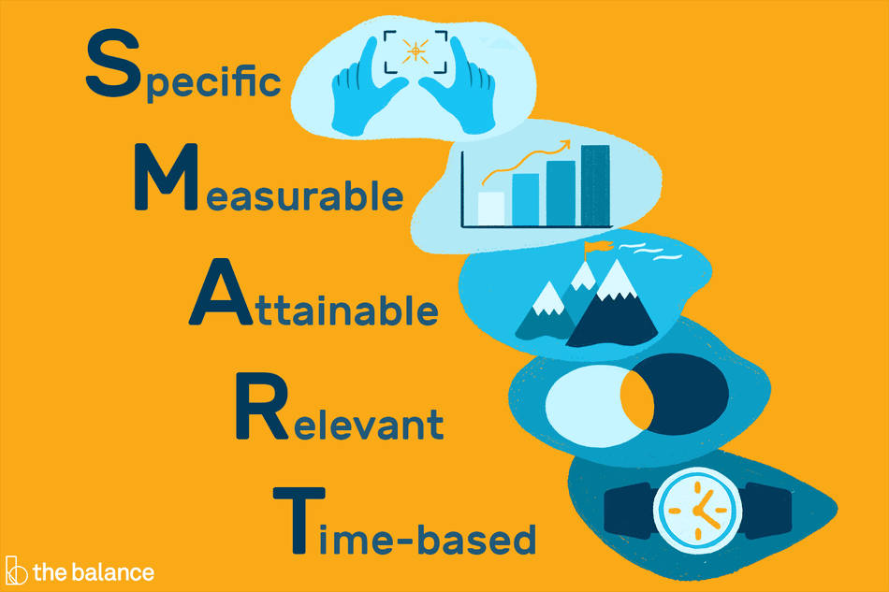
S.M.A.R.T.
Goals are part of every aspect of business/life and provide a sense of direction, motivation, clear focus, and clarify importance. By setting goals for yourself, you are providing yourself with a target to aim for.
Specific: Goals are well defined, clear, and unambiguous. They are specific and have a significantly greater chance of being accomplished.
To make a goal specific, the five “W” questions must be considered:
WHO is involved in this goal?
WHAT do I want to accomplish?
WHERE is this goal to be achieved?
WHEN do I want to achieve this goal?
WHY do I want to achieve this goal?

Slide 18
S.M.A.R.T.
Measurable: With specific criteria that measure your progress towards the accomplishment of the goal
To make a goal measurable, ask yourself:
How many/much?
How do I know if I have reached my goal?
What is my indicator of progress?
Achievable: Attainable and not impossible to achieve
Ask yourself:
Do I have the resources and capabilities to achieve the goal? If not, what am I missing?
Have others done it successfully before?
Notes:
A SMART goal must have criteria for measuring progress. If there are no criteria, you will not be able to determine your progress and if you are on track to reach your goal.
A SMART goal must be achievable and attainable. This will help you figure out ways you can realize that goal and work towards it. The achievability of the goal should be stretched to make you feel challenged, but defined well enough that you can actually achieve it

Slide 19
S.M.A.R.T.
Realistic: Within reach, realistic, and relevant to your life purpose
Ask yourself:
Is the goal realistic and within reach?
Is the goal reachable given the time and resources?
Are you able to commit to achieving the goal?
Timely: With a clearly defined timeline, including a starting date and a target date. The purpose is to create urgency.
Ask yourself:
Is the goal realistic and within reach?
Is the goal reachable given the time and resources?
Are you able to commit to achieving the goal?
Notes:
A SMART goal must be realistic in that the goal can be realistically achieved given the available resources and time. A SMART goal is likely realistic if you believe that it can be accomplished.
A SMART goal must be realistic in that the goal can be realistically achieved given the available resources and time. A SMART goal is likely realistic if you believe that it can be accomplished.

Slide 20
TAKE CHARGE Of YOUR CAREER
People who set and finish career goals tend to get more done and often ern more money than people who don’t set goals.
Some people used to rely on their boss or company to give them chances to advance.
Now it is up to you! If you don’t make it happen for you, no one else will.
In today‘s world of work , you need to take charge of your own career.

Slide 21
TAKE CHARGE Of YOUR CAREER
Good Reasons to Take Charge of Your Career in the New World Work
You Relate to Others: There is more of a “team” mindset in the workplace. Supervisors’ roles have changed from “parent” to “coach”. You decide how long you want to stay in one position. You also know that an employer can ask you to leave at any time if they don’t like your work.
You are Happier at Work: You can choose work that you find interesting. Since fewer job offer real security, why not do what you love?
You Keep Growing: To keep growing and moving up, you need to expand your skills, You need to build relationships with coworkers and others in your field. You must be flexible and able to adapt to changes in your work. You must be able to transfer your skills to different types of work.
You Know Who You Are: You get to choose the skills and experience you want to have. You can tell your story by talking about what you can do. For example, you don’t have to say “ I work for XYZ company.” You can say “ I am good with hands and I have excellent skills from four year of paining houses”.

